Slide 1
Unilever Data Science POC Use Case
Team - 3_Idiots
Jang Bahadur
Satyam Satyajeet
Jai Bhagat

Slide 2
Stage 1

Slide 3
Problem Statement
One of our brands is going through some major changes in business execution plans and will like to know.
i. What are the major drivers for sales(EQ)?
ii. Knowing the drivers, how accurately we can predict future sales for next 6 periods?

Slide 4
Assumption
As training data was day wise we need to aggregate and make period (with 28 days ) and then aggregate om this period to get mean of all the variables as test data was given from 2016 period wise
generated periods and year based on previous assumption

Slide 5
What are the major drivers for sales(EQ)?
To find the best drivers two approaches were used.
Correlation Matrix
Feature importance of all the variables were done using Light GBM was done.

Slide 6
Steps Followed
As data is numeric, no encoding techniques are used.
As we are using tree based model, so no outlier treatment required.
test,train split was 0.80,0.20.
We used GBM, Random Forest, MLP, Light GBM modelling techniques
Loss function is used as RMSE because data has fluctuation on both sides of the tail. RMSE is best metric to use in such scenerios.
As NN and light GBM are good result.

Slide 7
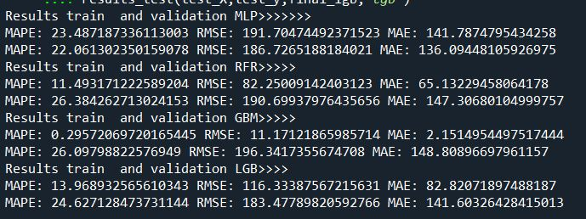
Cross validation Results

Slide 8
Final Model
NN is always predicting on the lower side
Light GBM is predicting on the higher side
So, we ensemble the models, NN(35%) and Light GBM(65%) on this proportion to keep the data in normal distribution.
New data is just shared 1 day before so we are still working.

Slide 9
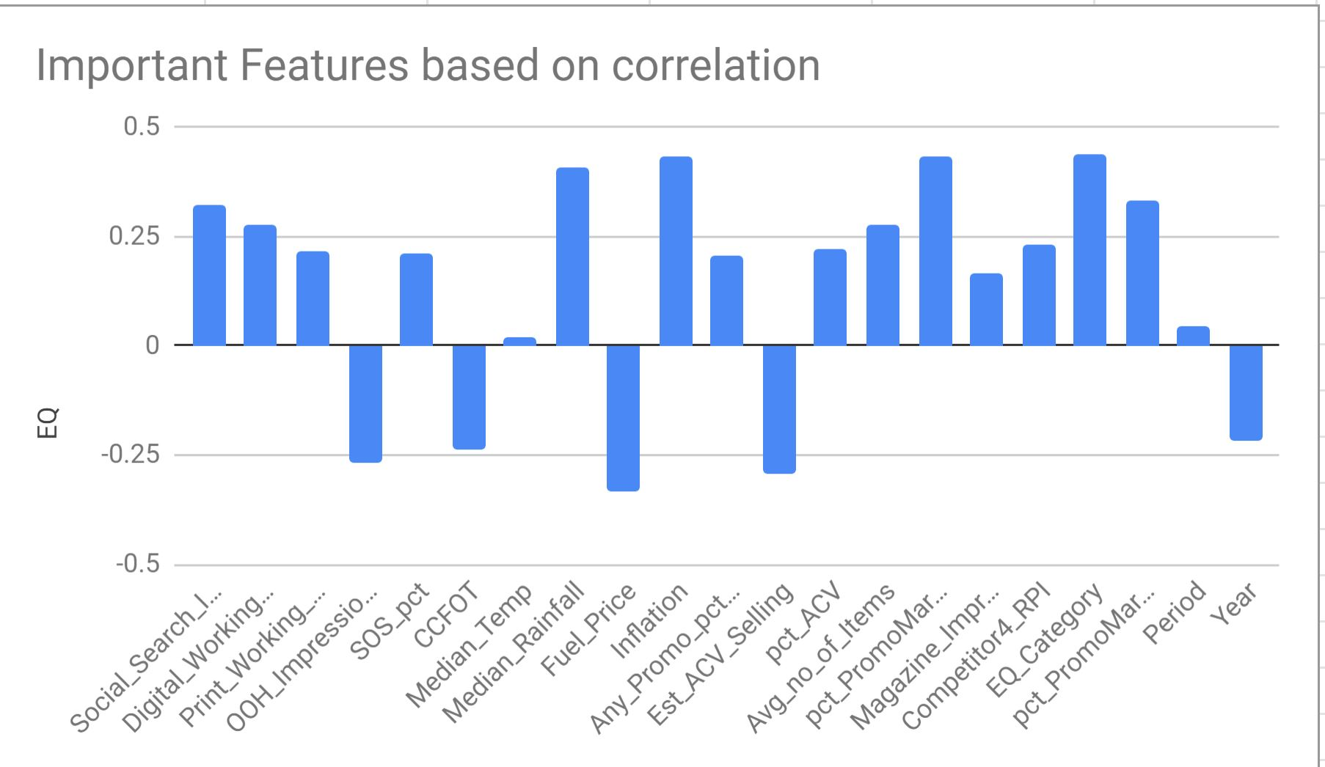
Correlation between Important Features

Slide 10
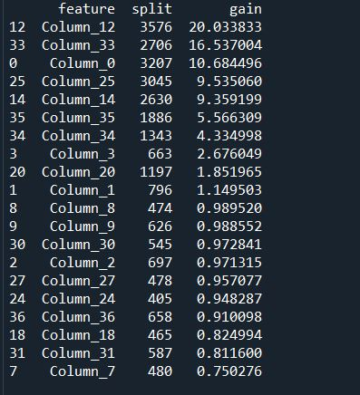
From Light GBM Importance
Social search Impression
Social Search Working Cost
Median Rainfall
Digital Impression
Inflation
A combination of these 10 variables were used to build the models and results found were effective.

Slide 11
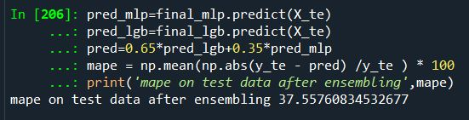
Knowing the drivers, how accurately we can predict future sales for next 6 periods?
Note :
The final MAPE score achieved is 37 on test data

Slide 12
Model Framework
MLP(35%)
Ensemble model
Final Output
Light GBM (65%)

Slide 13
Stage 2

Slide 14
Assumptions
Data is high dimensional p>n

Slide 15
Process Flow
To get rid of dimensions, we used XGBoost as a feature extractor with gain >= 50
Missing values are treated with forward and backward fill as it is time-series data
Derived variable: We used mean encoded period to use period as variable

Slide 16
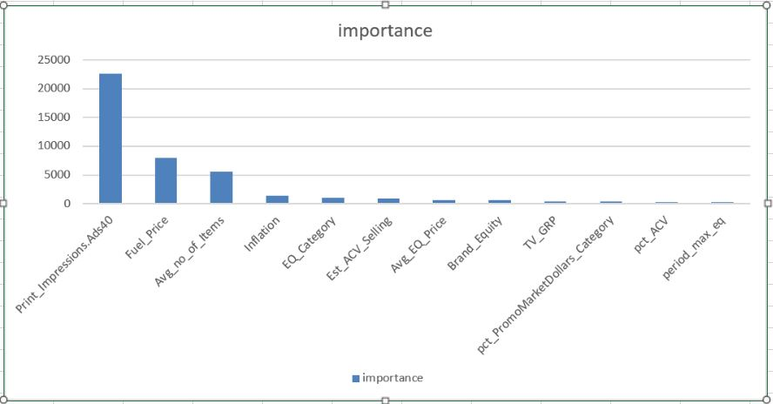
Feature Importance/Dimension Reduction

Slide 17
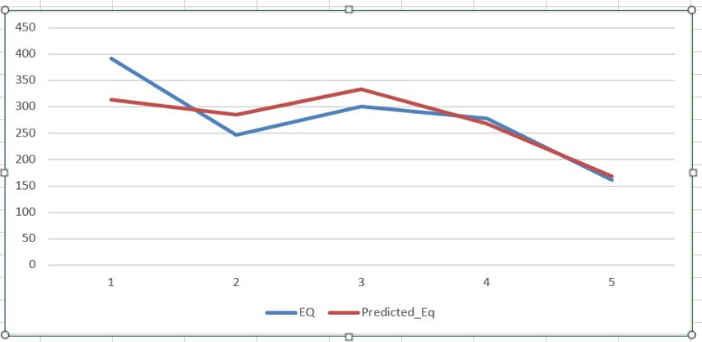
Actual vs Pred XGB

Slide 18
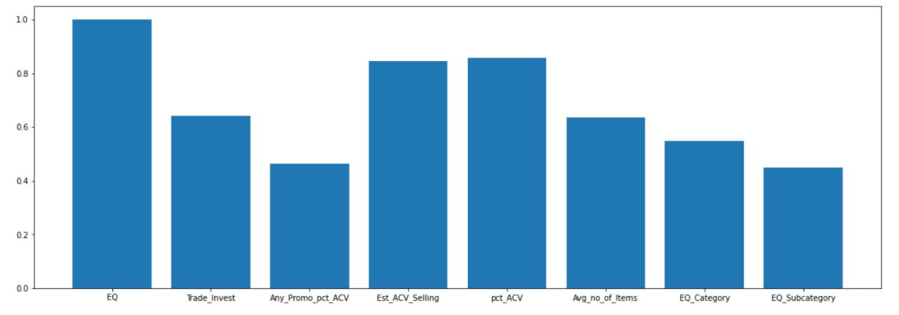
Correlation Plot

Slide 19
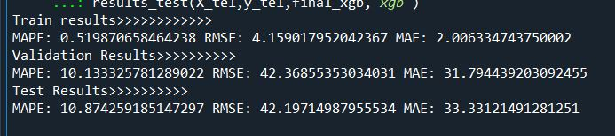
Result and Discussion
XGBoost
Here we can see, this model is stable as mean absolute error, RMSE and MAPE are almost equal on validation and test dataset
Final MAPE as an evaluation metric is 10.8

Slide 20
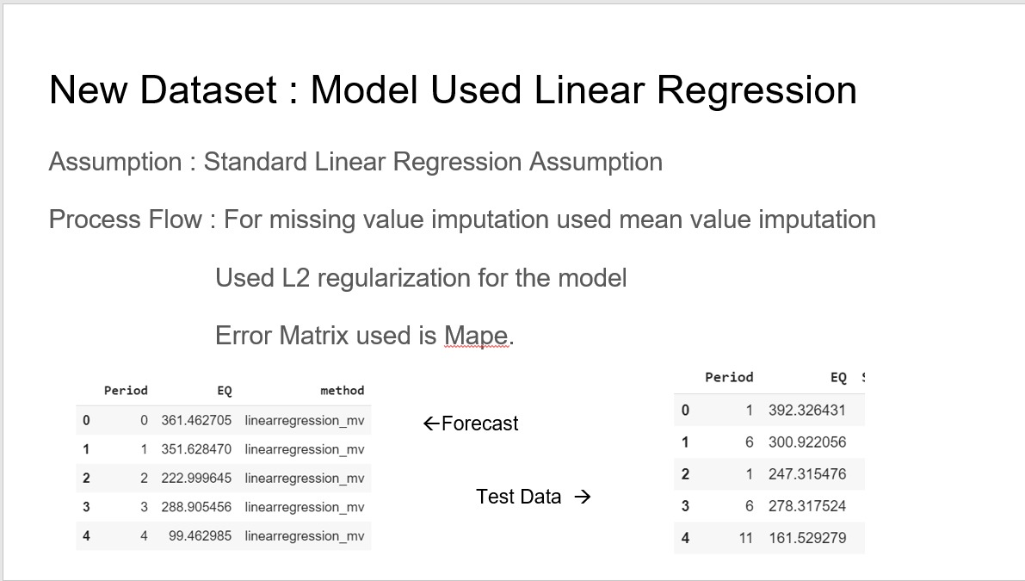
Result and Discussion
Ridge Regression

Slide 21
